Slide 1
Nike Shop - Product Management System
A Python Flask Application with MySQL Database
Made by:
Ahmad Samer Yahya – 202010734
Mohammad Abu Saa - 202110311

Slide 2
Introduction
Overview:
- Brief description of the project.
- The goal of the project: To manage Nike product orders using a web interface.

Slide 3

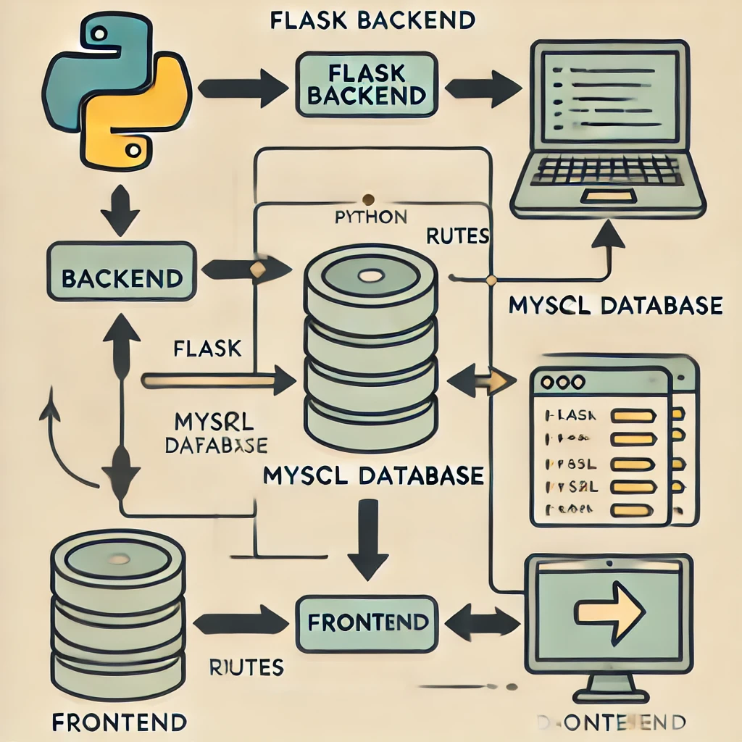
Project Architecture
Components:
- Flask: Backend framework.
- MySQL: Database management.
- HTML/CSS: Frontend interface.

Slide 4
Backend - Flask Application
File: app.py
Key routes: /
/product_list
/add_product
/edit_product/<int:product_id>
/delete_product/<int:product_id>

Slide 5
Database Configuration
MySQL Connection:
- Host: localhost
- User: root
- Password: 12345678
- Database: nikeshop
Table Schema:
- Table: My_Product
- Columns: product_id, name, amount, phone

Slide 6
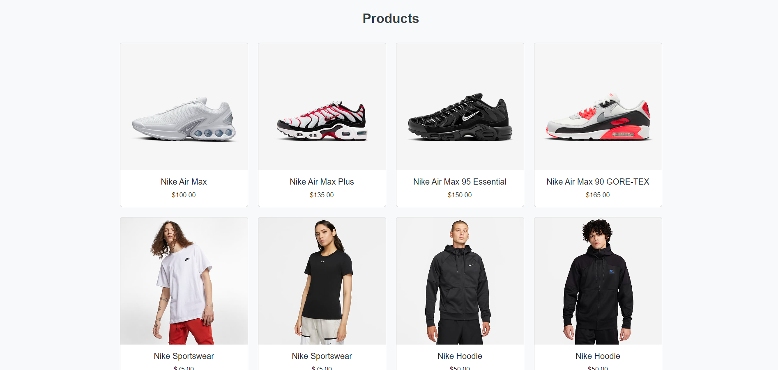



Frontend - Index Page
File: index.html
- Description: Main landing page.
- Key elements: Navbar, header, product display section.

Slide 7
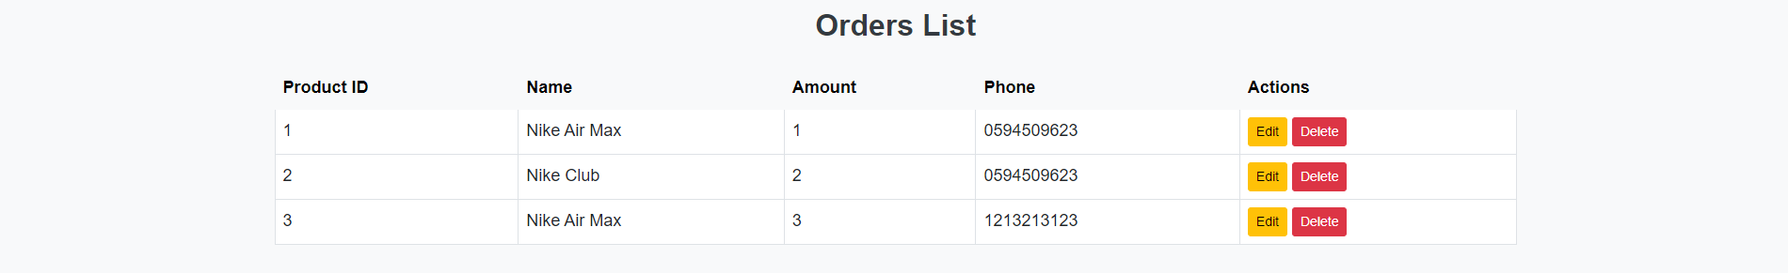
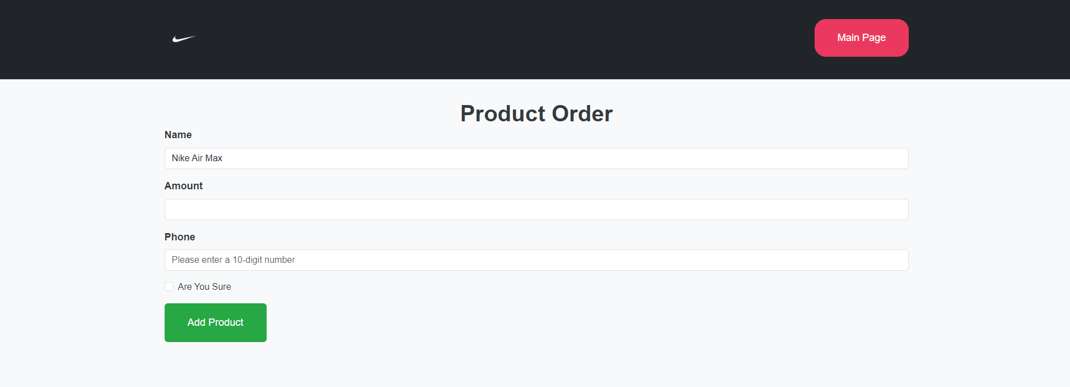
Frontend - Product List
File: product_list.html
- Description: Order Product and Displays the list of products you ordered
- Key features: Add, edit, delete products.

Slide 8
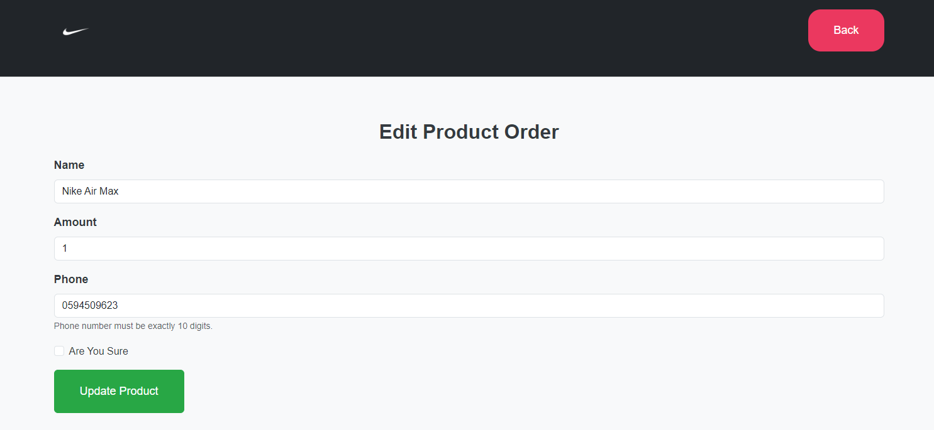
Frontend - Edit Product
File: edit_product.html
Description: Form to edit an existing product.
Fields: Name, Amount, Phone
Key validations: Amount > 0, Phone number is 10 digits.
Flash Messages: For validation errors.

Slide 9
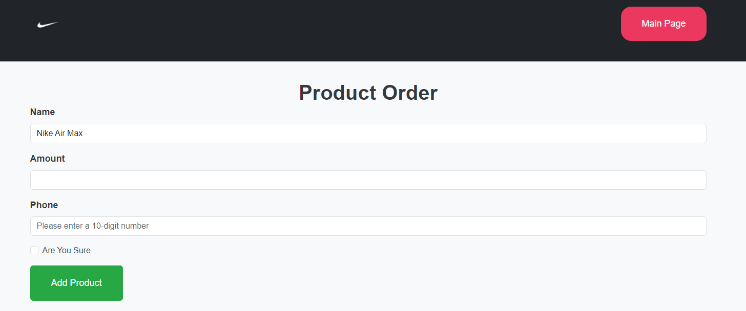
Adding a Product
Form Details:
- Fields: Name, Amount, Phone
- Validation: Amount > 0, Phone number is 10 digits
- Flash Messages: For validation errors.

Slide 10
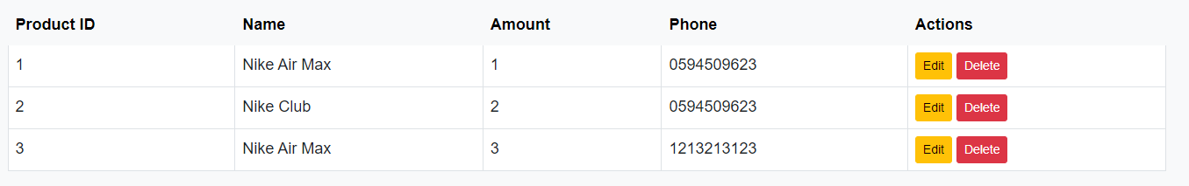
Deleting a Product
Process:
- Confirmation before deletion.
- SQL query to delete and re-index the product IDs.

Slide 11
Demonstration
Live Demo:
- Walkthrough of adding, editing, and deleting a product.

Slide 12

Thank you for listening
Any Questions?

